Slide 1
PAAC North Shore Extension: Design Review
On Track Trainwreck

Slide 2
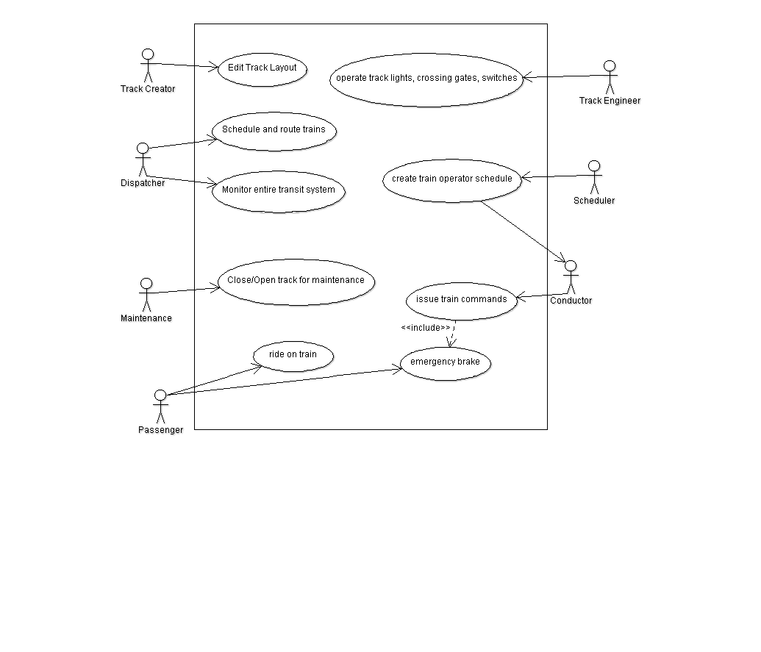
System Overview

Slide 3
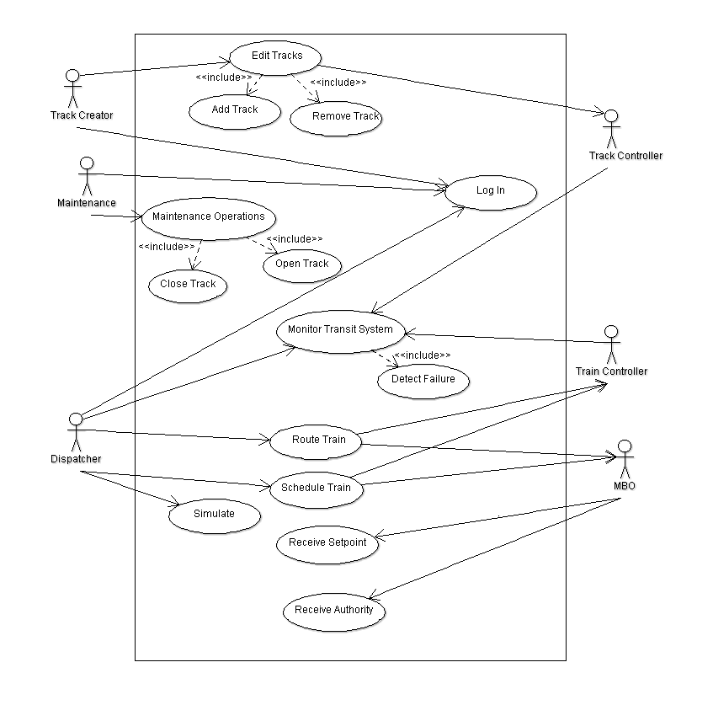
CTC Office Use Cases

Slide 4
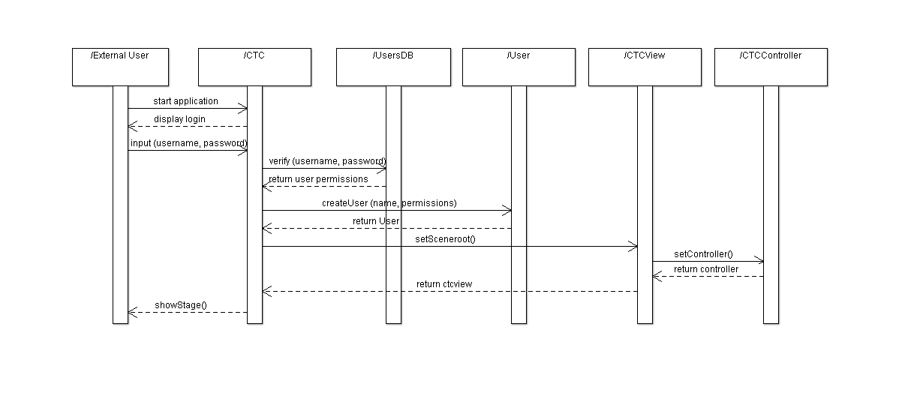
CTC – Login Sequence Diagram

Slide 5
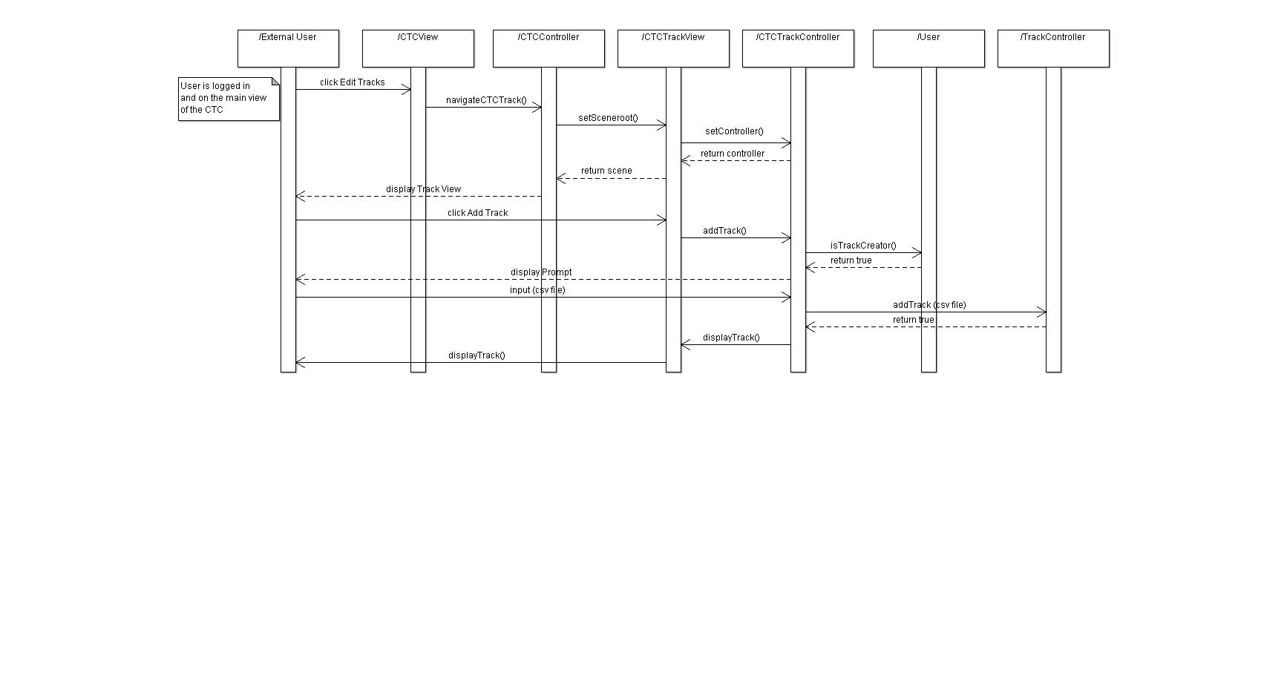
CTC Add Track Sequence Diagram

Slide 6
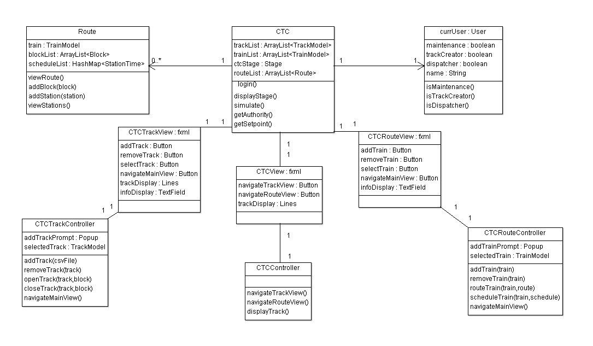
CTC Class Diagram

Slide 7
Moving Block Overlay
Purpose
Calculate the safe stopping distance and Moving Block speed and authority for each train.
Switch mode between Moving Block and Fixed Block operation.
Schedule Transit Operators.
Track Passenger Movement.
Requirements
The MBO is a vital controller.

Slide 8
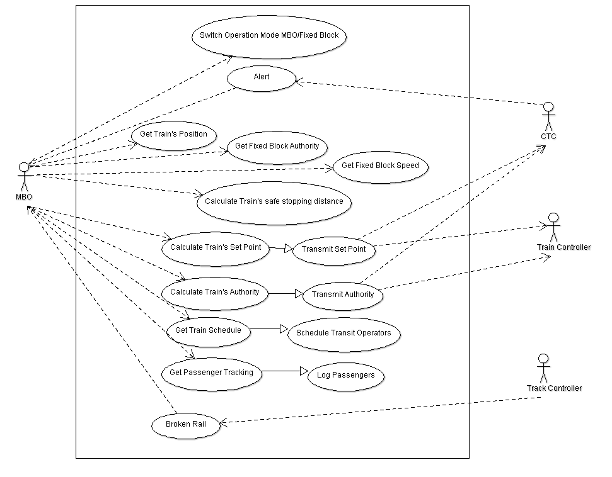
MBO Use Cases

Slide 9
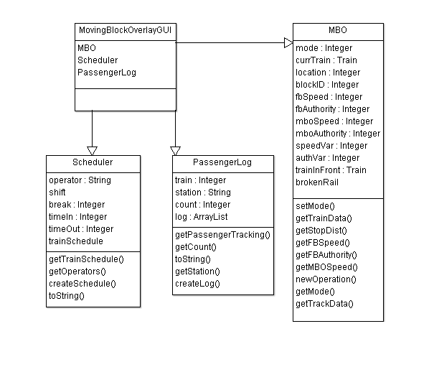
MBO Class Diagram

Slide 10
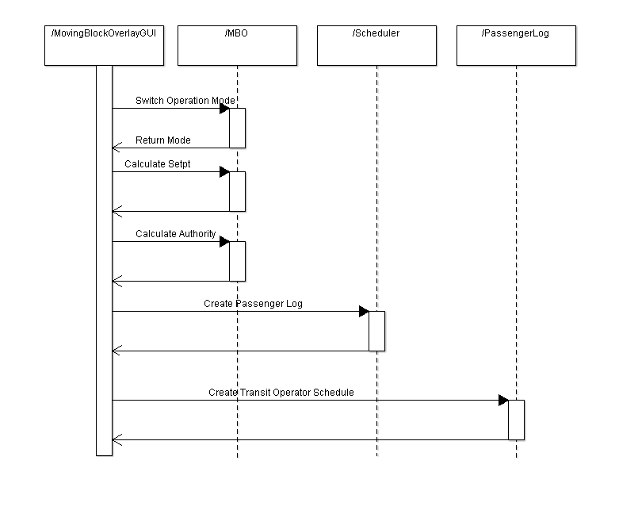
MBO Sequence Diagram

Slide 11
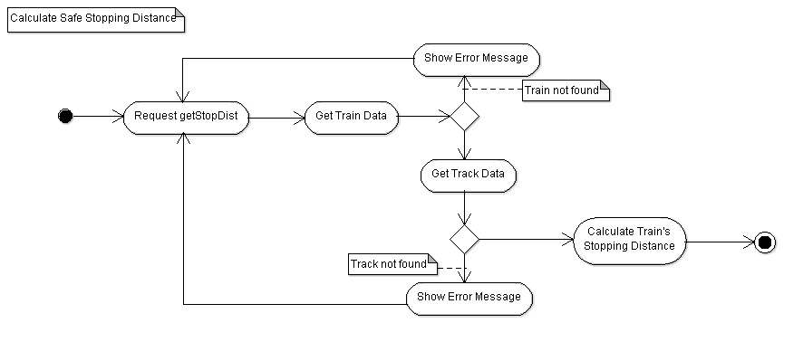
MBO Activity Diagram

Slide 12
Train Model
Purpose
Accepts input regarding the setpoint power, brake command, speed limit, acceleration limit, deceleration limit, route information, temperature control, door open, door close, transponder input, track circuit input, and light controller for tunnel.
Calculates the speed of the train based upon power input.
Displays information about next stop
Simulates train failures

Slide 13
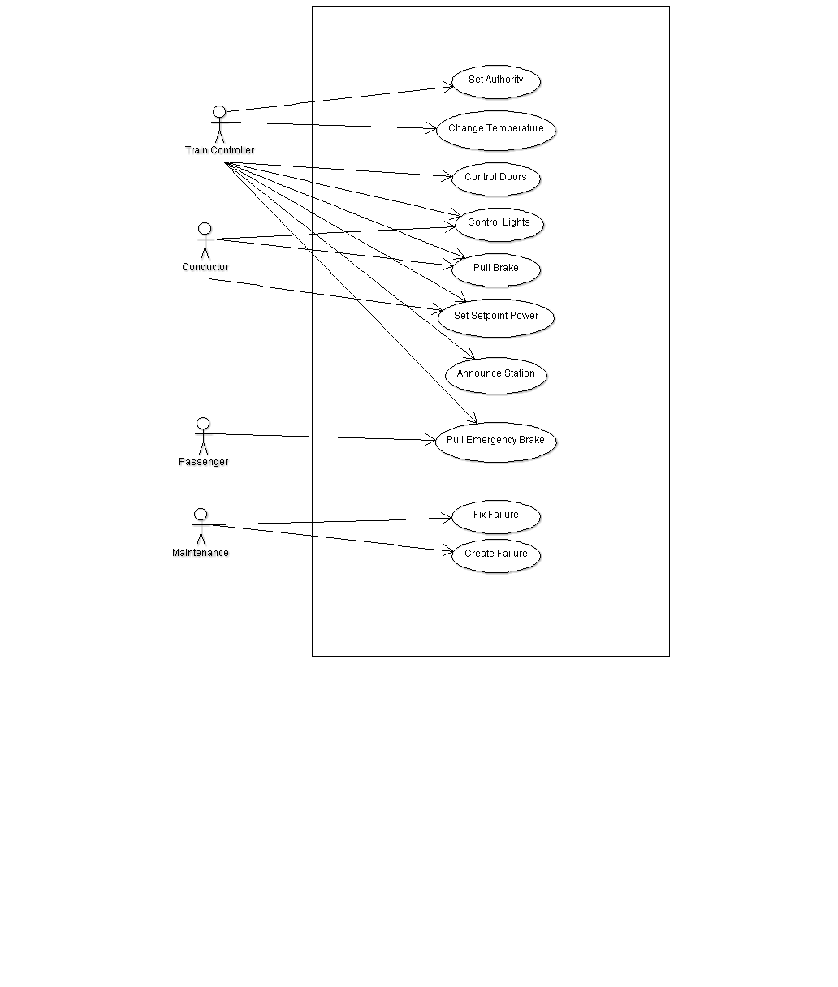
Train Model/Controller: Use Cases

Slide 14
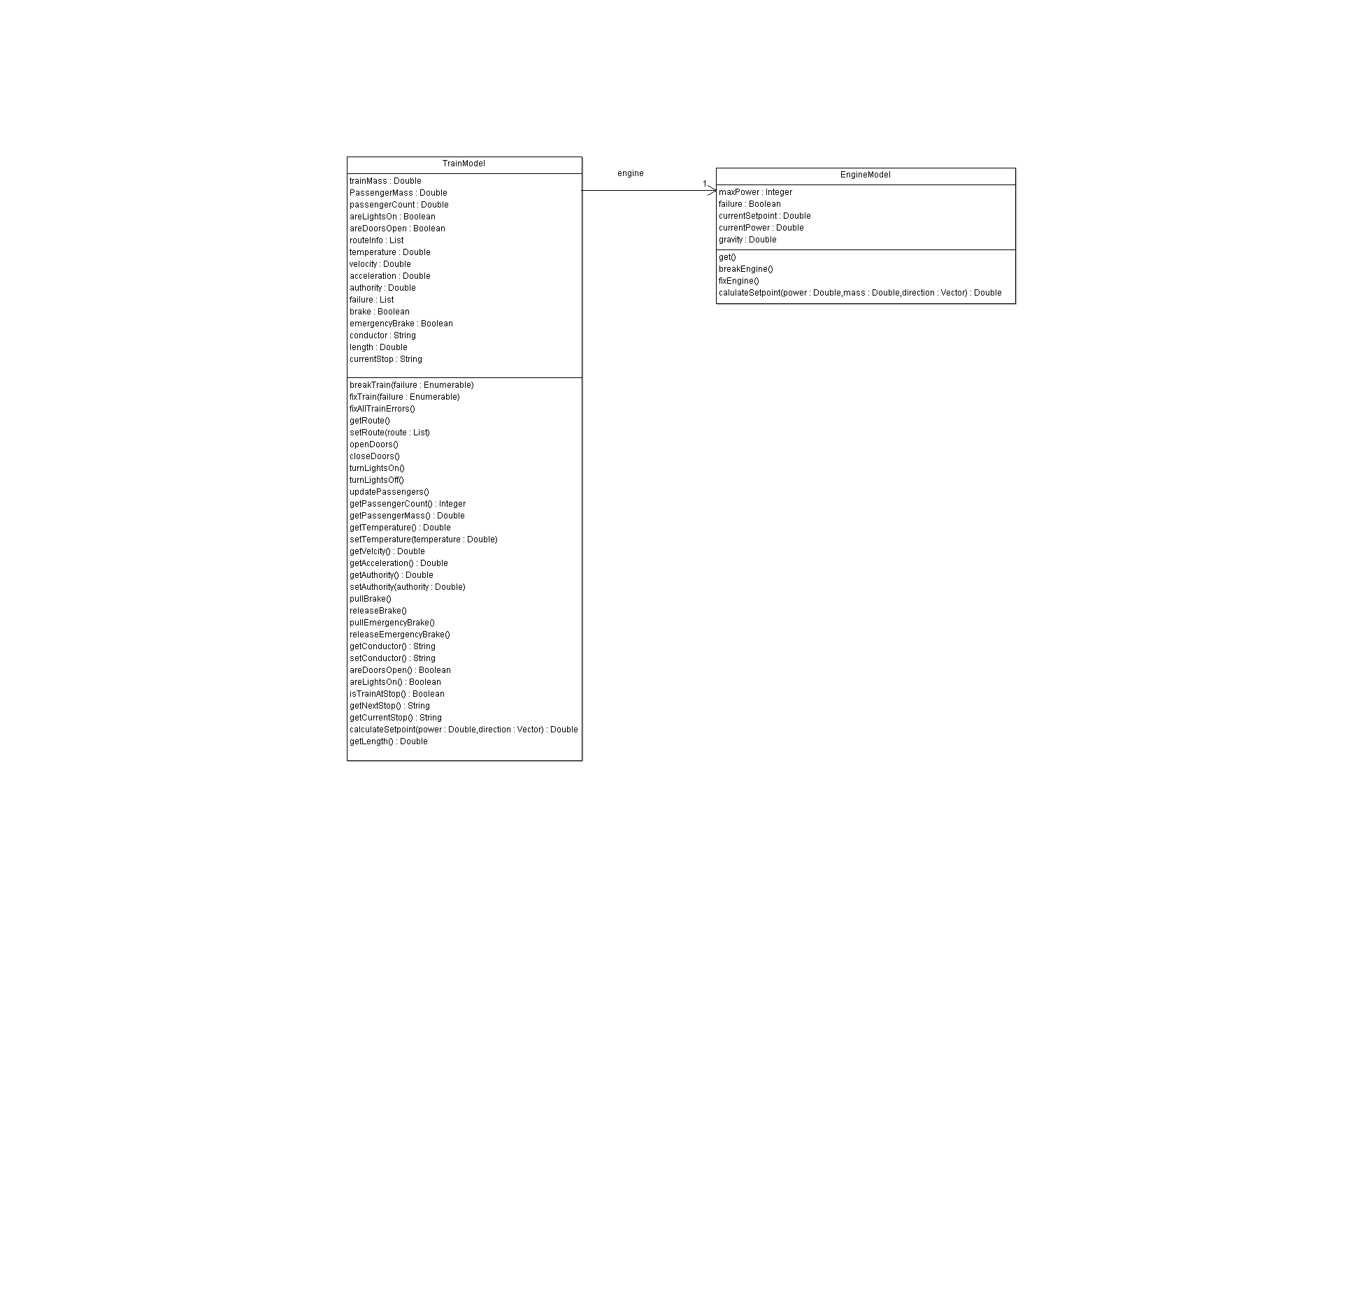
Train Model: Class Diagram

Slide 15
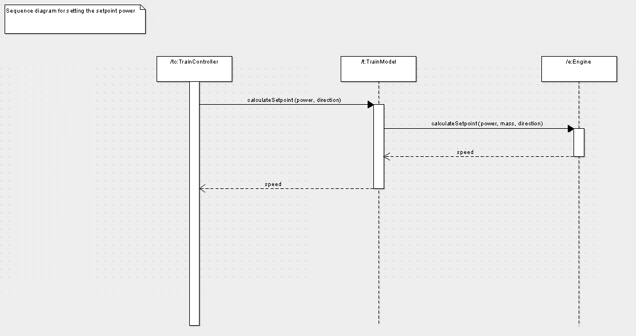
Train Model: Sequence Diagram

Slide 16
Train Controller
Purpose
Regulates train to the correct speed
Ensure that the train does not exceed speed limit or authority
Takes input from the Engineer on power or speed
Requirements
Contains some vital controls
Non-vital controls may be separated from vital ones

Slide 17
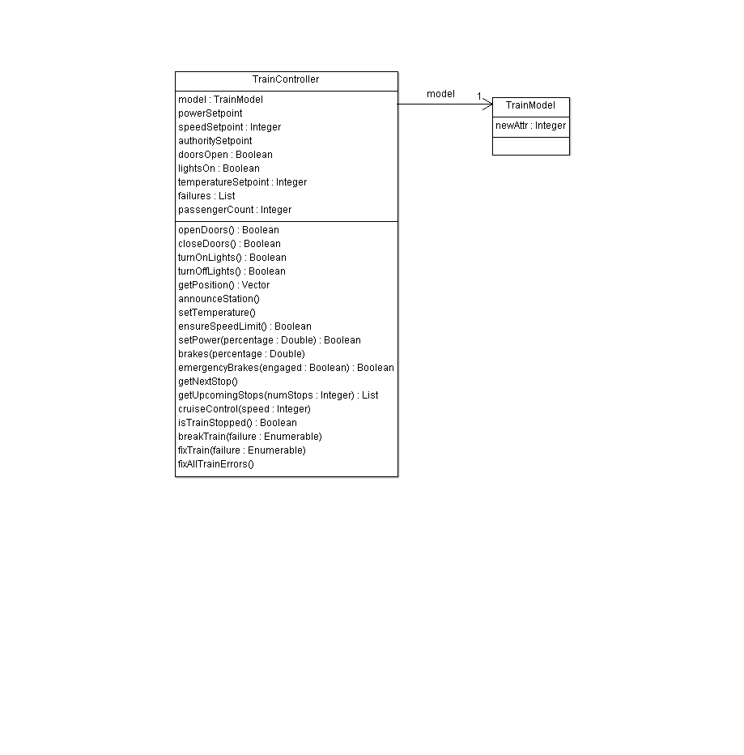
Train Controller Class Diagram

Slide 18
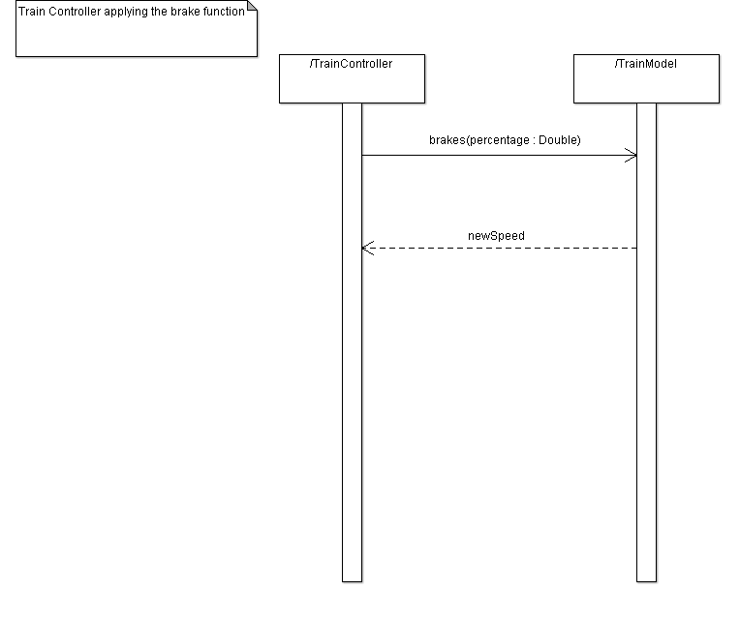
Train Controller Sequence Diagram

Slide 19
Track Controller
Purpose:
Signaling
Create signals for each block of track
Report current track block signal status
Control RR Crossings.
Detect and Report Track faults
Alter Switches on the track based on train destination
Report block information to train
Calculate fixed block authority
Send Vital Information about track to train controller

Slide 20
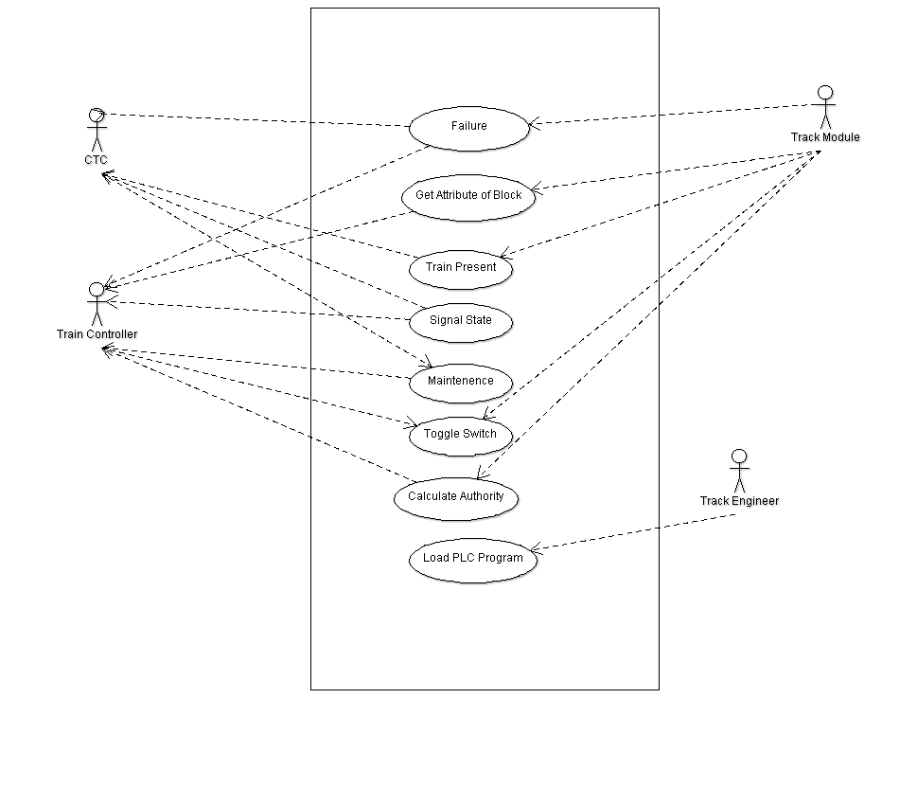
Use Cases: Track Controller

Slide 21
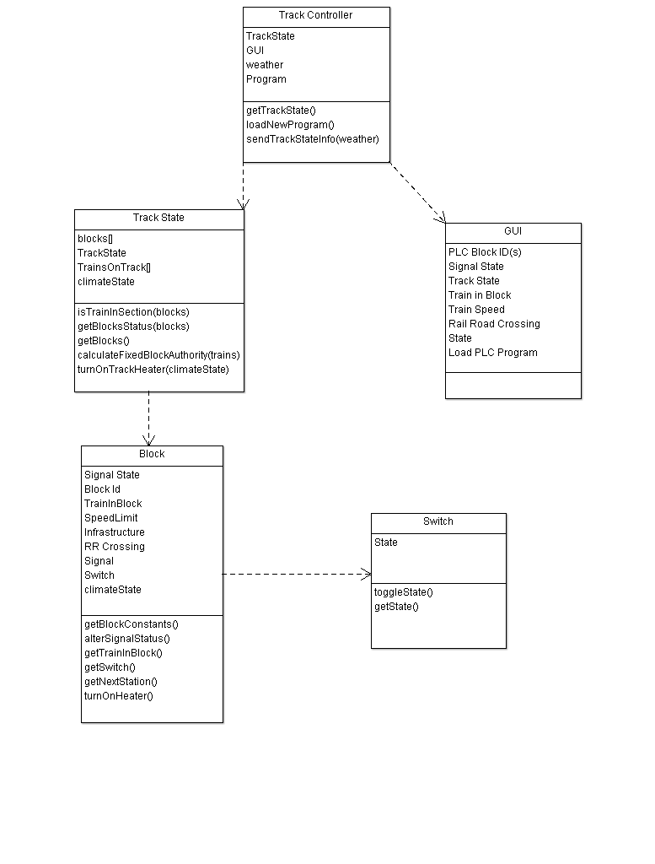
Track Controller: Class Diagram

Slide 22
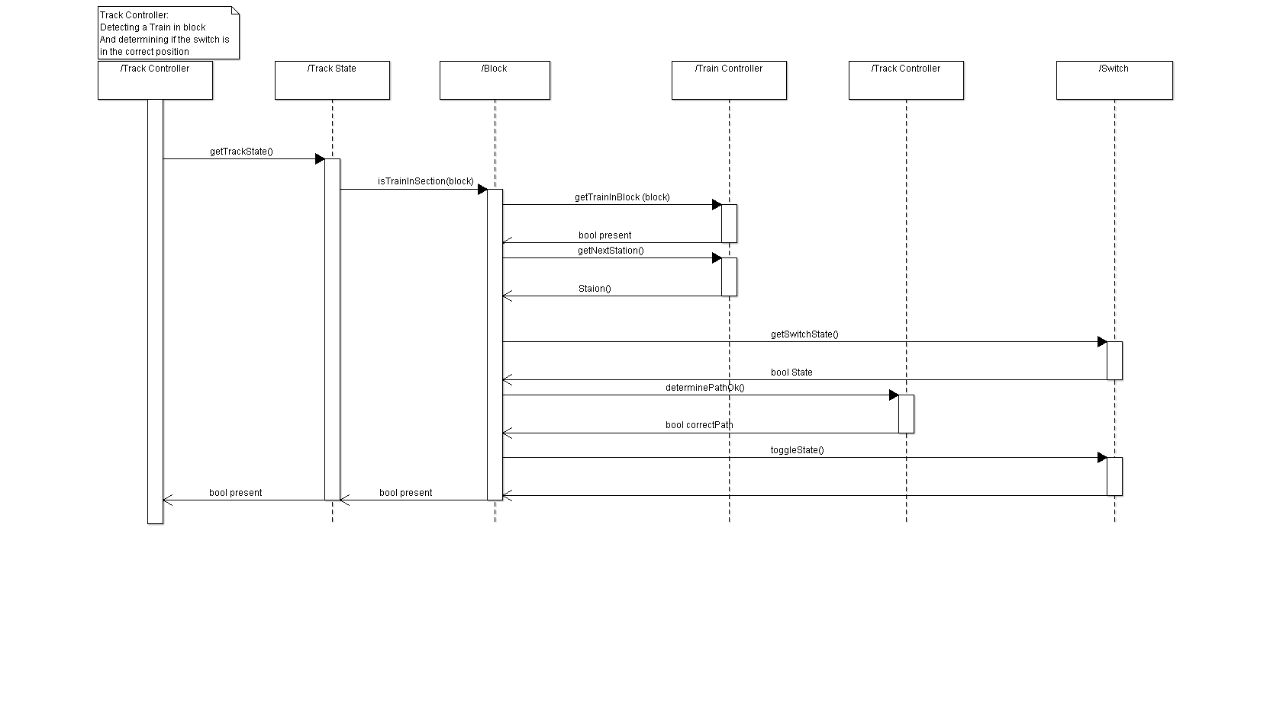
Track Controller: Sequence Diagram

Slide 23
Track Model
Purpose
Creates the train from an inputted Excel file
Implements a train detection circuit
Holds all info for each block in a Database
Returns block specifications when track controller requests for them
Status Indicators for broken rails, track detection circuit failure and power failure

Slide 24
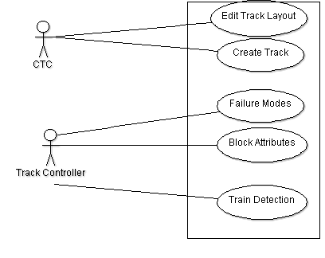
Track Model: Use Cases

Slide 25
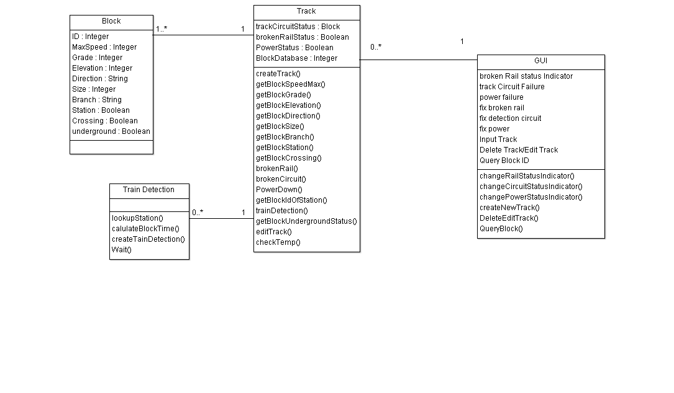
Track Model: Class Diagram

Slide 26
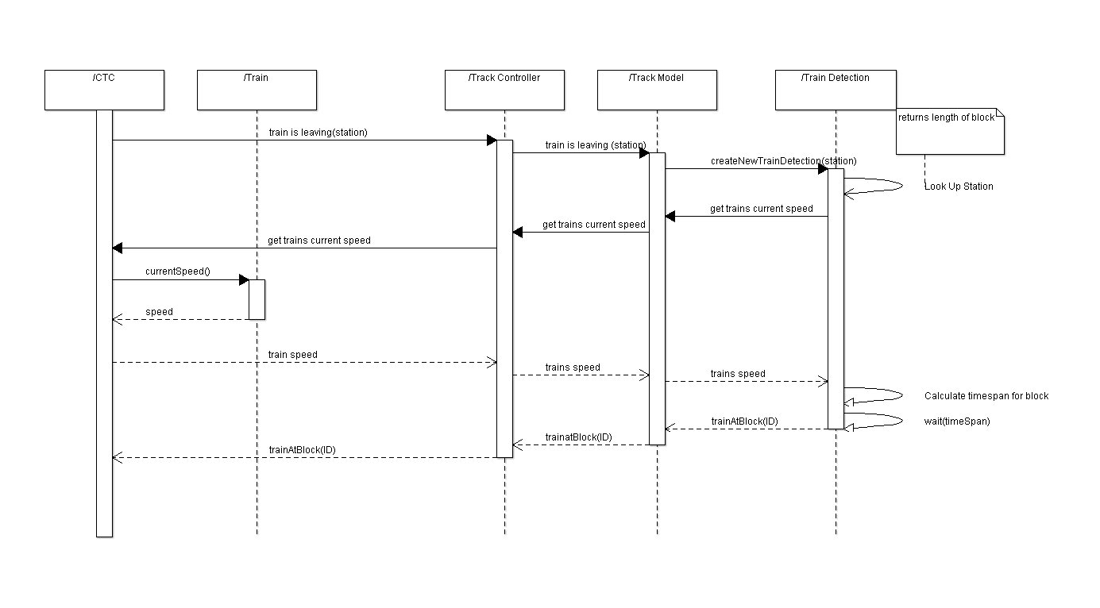
Track Model: Sequence Diagram

Slide 27
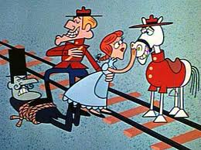
Any Questions

